Slide 1

Group 4
Nihal Patel (Product Owner)
Parthasarathy Rajendiran
Varshan Sankar
CSCN8030 – AI for Business Decisions and Transformations

Slide 2
Project Brief
Example Project Pitch | Social Organization / NGO
Example Organization or Category | Feed Ontario
Description of Organization | Feed Ontario is a reputed food bank network in the province of Ontario with the mission to champion an impactful network of hunger relief organizations and advocate for solutions to end food insecurity and poverty in Ontario.
Two Specific Ethical Considerations in AI Adoption | Ensuring Fair Distribution of Food and Aid. Protecting Privacy and Data Security
(Who We Are, n.d.)

Slide 3
Operational Decisions | AI-Powered Risk Assessment: Utilizing AI algorithms to assess and predict potential risks and vulnerabilities in specific regions or communities prone to natural disasters. Real-Time Data Analysis: Leveraging AI technologies to analyze real-time data, such as weather patterns, social media updates, and sensor information, to inform decision-making during emergency situations.
Tactical Decisions | Logistics and Supply Chain Management: Optimizing the supply chain process to ensure timely delivery of essential resources, such as food, water, medical supplies, and temporary shelters, to affected areas. Volunteer and Resource Mobilization: Coordinating efforts to mobilize volunteers, donations, and resources to support emergency response operations and meet the immediate needs of affected communities.
Strategic Decisions | Partnerships and Collaborations: Forming strategic partnerships with other NGOs, government agencies, and international organizations to enhance the effectiveness of emergency response and disaster management.

Slide 4
Why this topic is important? | Humanitarian Impact: Effective emergency and disaster response can save lives, protect livelihoods, and alleviate suffering in affected communities. Sustainable Development: Integrating emergency response and disaster management into sustainable development goals can contribute to long-term resilience, reduce vulnerability, and promote sustainable recovery.
How could this project make an impact outside of class? | Global Humanitarian Assistance: By providing effective emergency response and disaster management, the NGO can contribute to global humanitarian efforts, extending support to communities worldwide. Collaboration and Partnerships: By collaborating with other NGOs, government agencies, and international organizations, the NGO can foster cooperation, innovation, and collective action in addressing global emergency and disaster challenges.
Why should the class choose this topic? | Real-World Relevance: Emergency and natural disaster response is a pressing global issue that requires practical solutions and interdisciplinary approaches. Global Perspective: Understanding emergency and disaster response will enable students to appreciate the challenges faced by different communities worldwide and develop a cross-cultural understanding of humanitarian issues.

Slide 5
Sprint 1 Use Case: AI Powered Risk Assessment
Data Source: https://cdd.publicsafety.gc.ca/prnt-eng.aspx?cultureCode=en-Ca&provinces=9&normalizedCostYear=1&dynamic=false
Extracted using BeautifulSoup library

Slide 6
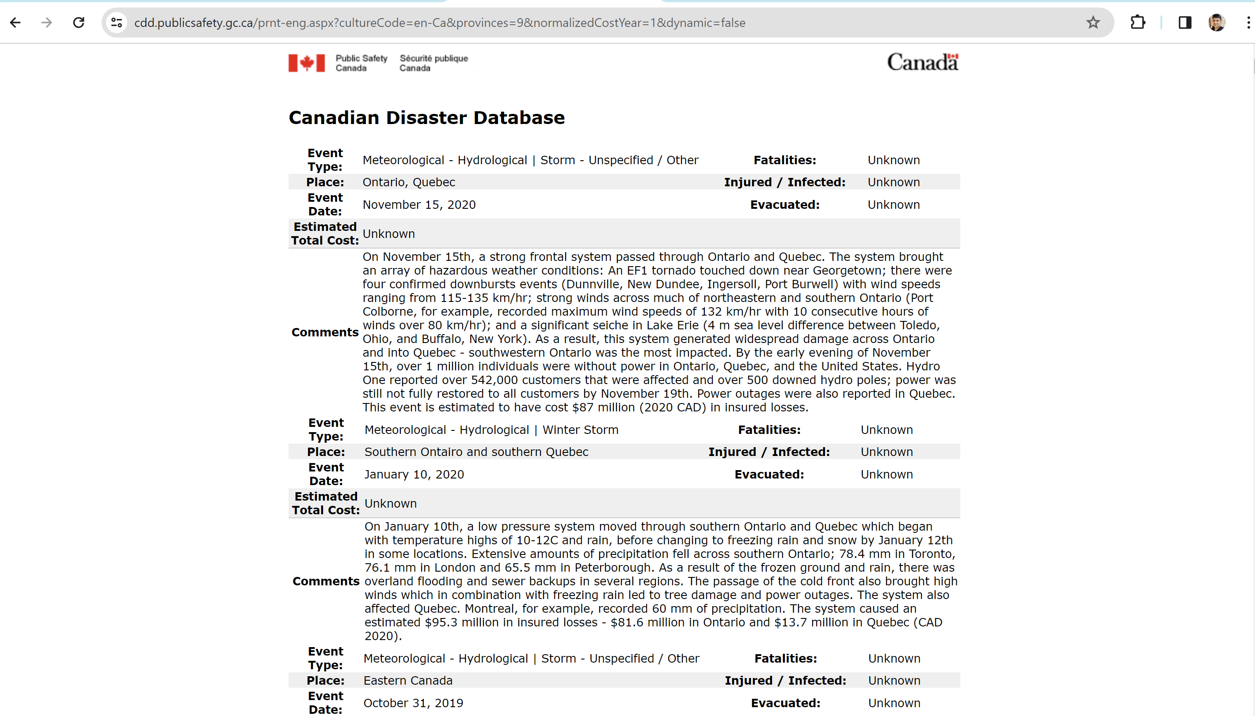

Slide 7
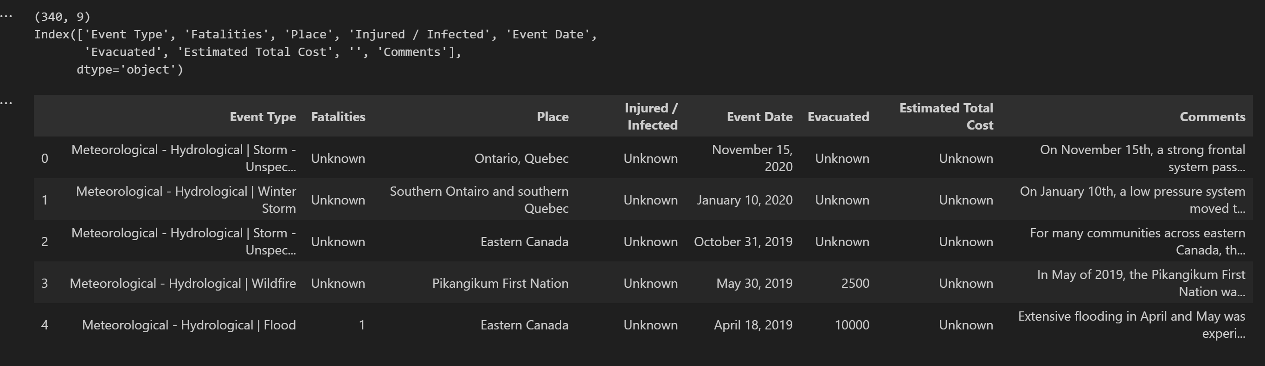

Slide 8
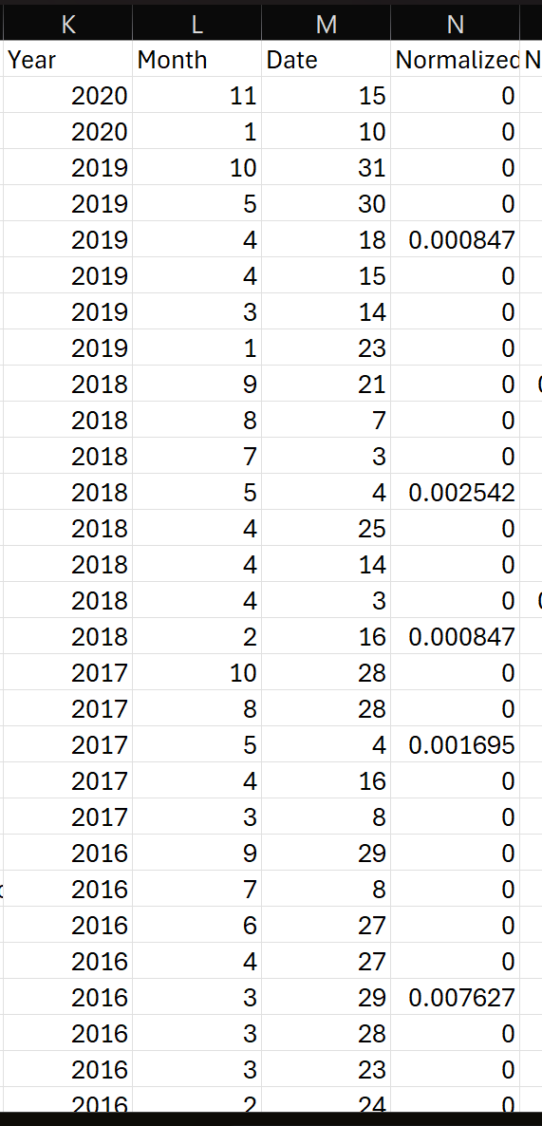
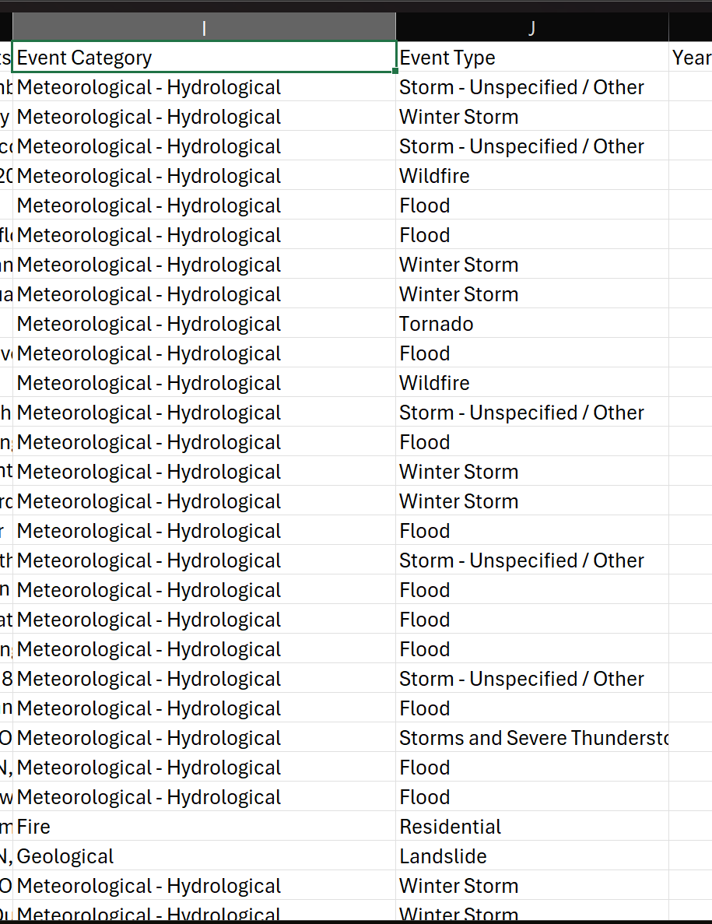
Feature Engineering

Slide 9
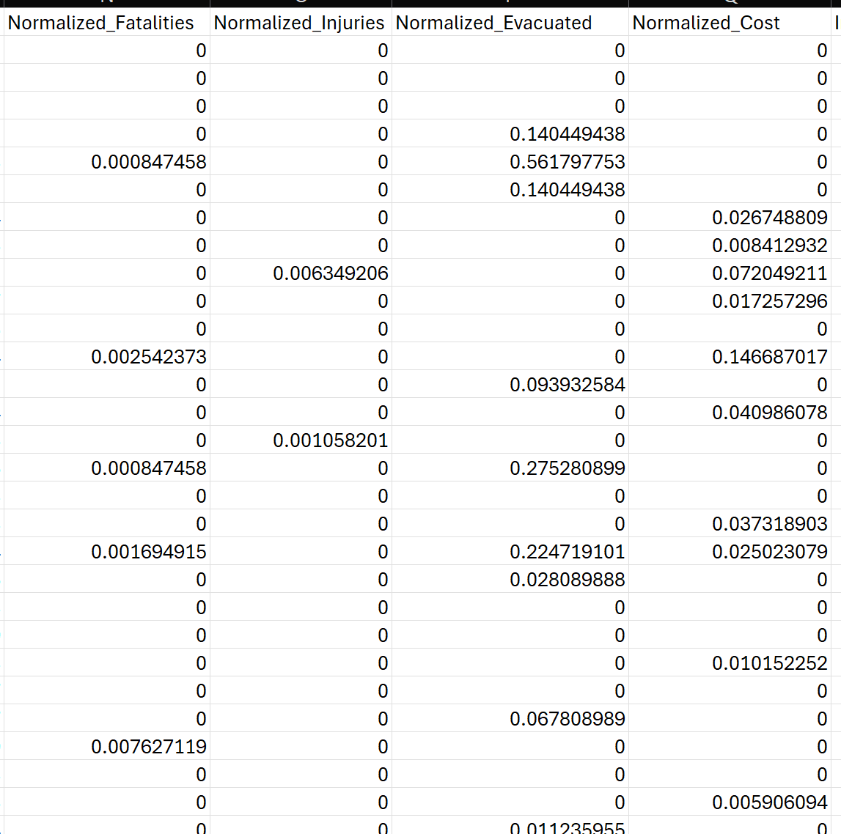

Slide 10
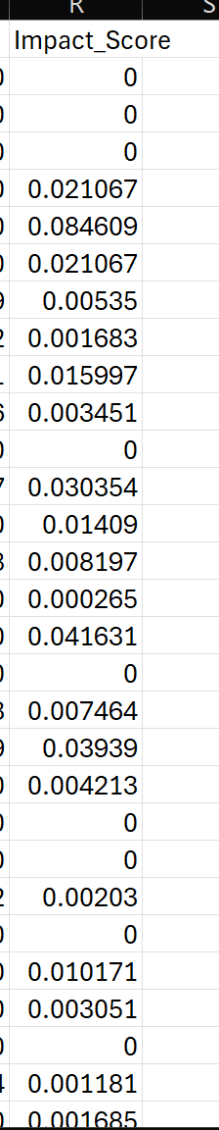
w_fatalities = 0.4
w_injuries = 0.25
w_evacuated = 0.15
w_cost = 0.2

Slide 11
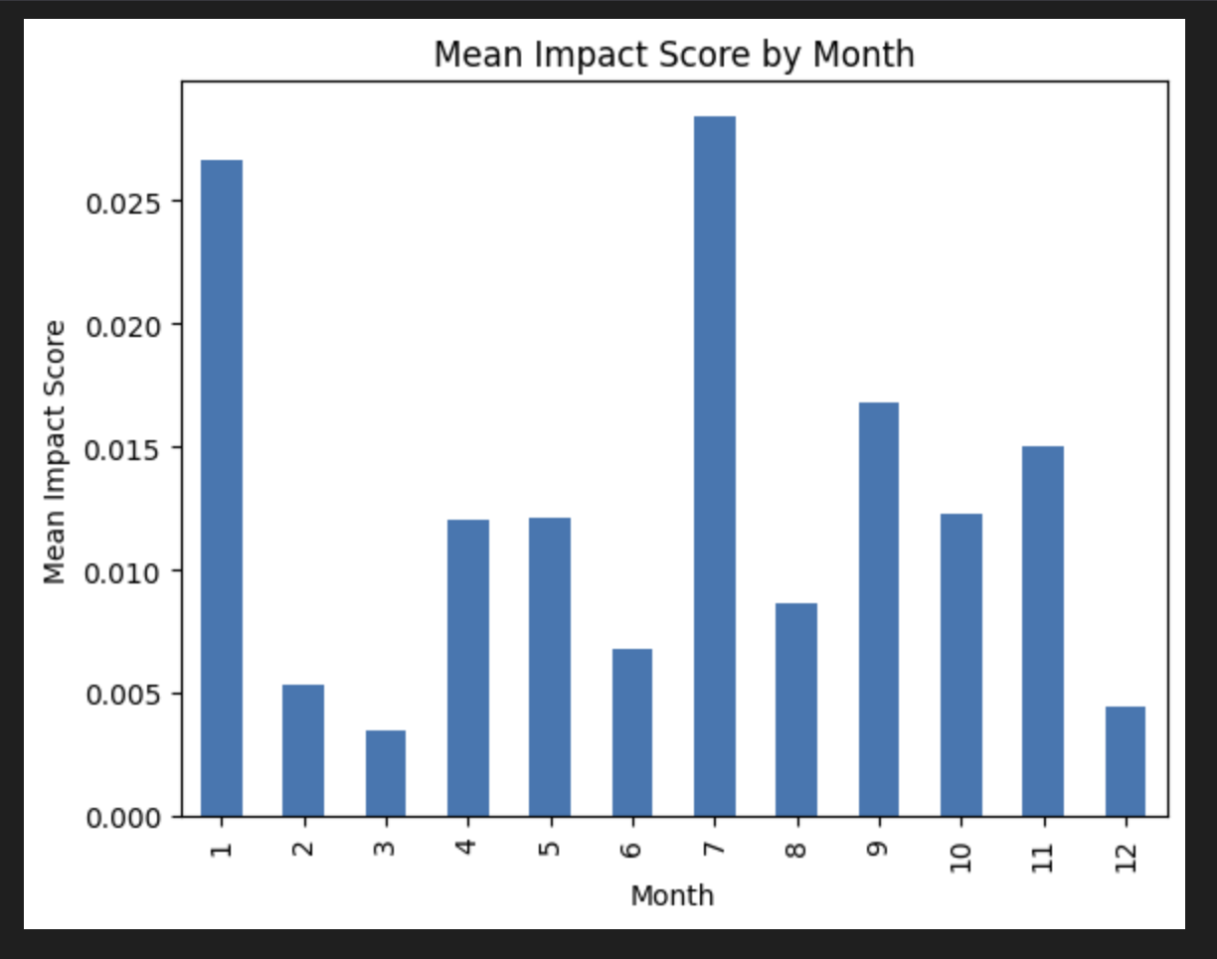

Slide 12
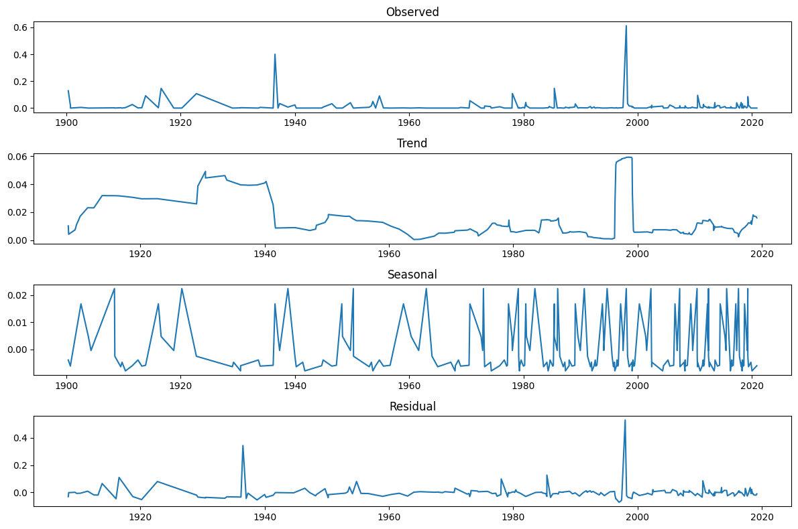
Decomposition of the Time series data

Slide 13
SARIMA Model
Seasonal Auto Regressive Integrated Moving Average model is used for Time series forecasting especially when datasets have seasonality and trends related to natural disaster occurrences.
It can handle time series data with seasonality.
It allows to capture dependencies between observations and incorporate lagged values and past errors into the model.

Slide 14
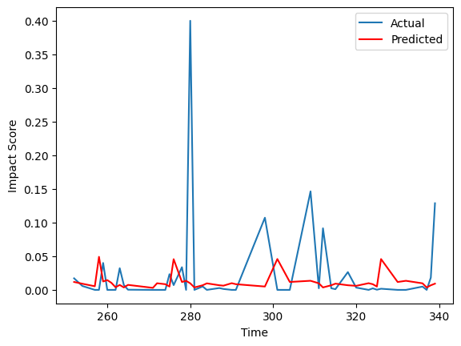
Forecasted data using SARIMA model

Slide 15
References
Who We Are: Vision & Mission. (n.d.). Feed Ontario. Retrieved January 17, 2024, from https://feedontario.ca/about-us/who-we-are/

